Slide 1
Program Charter, Security Champions Guidelines and Best Practices, Training Material

Slide 2
Introduction to Security Champions Program
Improve security in your software development life cycle
Introduction of the Security Champion
What’s in it for me or my team?
Current status – work being picked up by Champions
The bigger picture

Slide 3
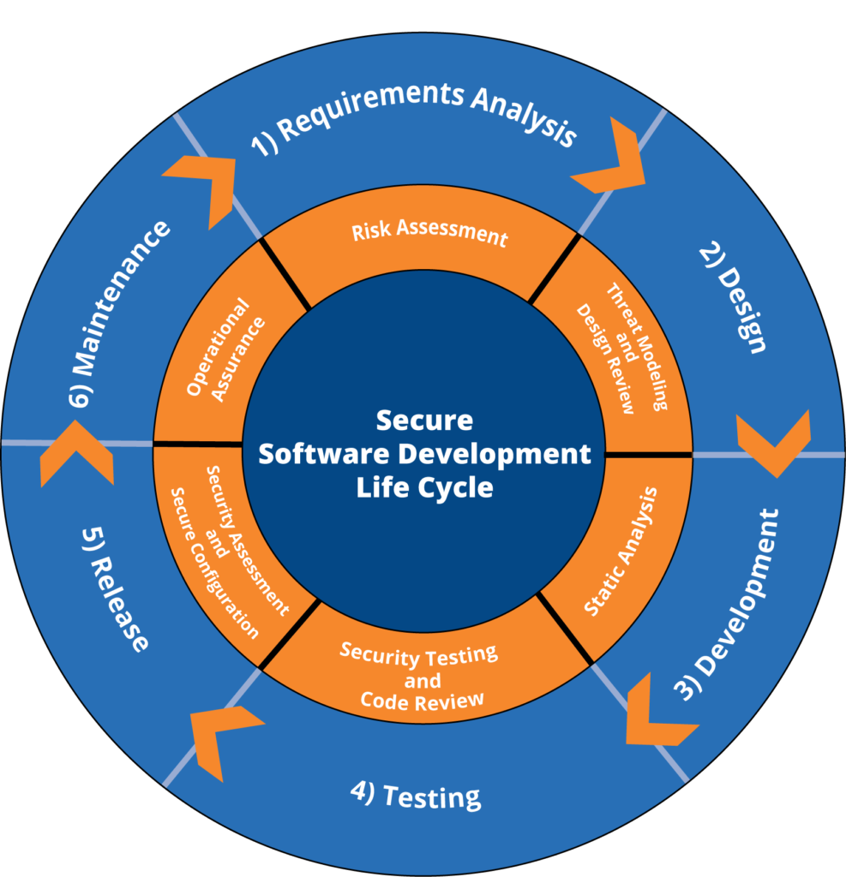
Identifying and addressing security issues as early as possible by not thinking about security at the end of the SDLC, but by making it an integral part of the entire software development process.
Stay updated in new vulnerabilities , patches for example
Conducting initial threat modeling sessions and facilitating ongoing reviews.
Checking of changes with Security in mind
Ensuring security is a priority in code reviews and development practices.
Overseeing security testing such as Static and Dynamic Analysis (SAST, DAST).

Slide 4
Security Champion
“A Security Champion can be defined as a DevOps engineer aware of common security issues. Who can judge whether or not a security test is needed and in which form, can perform those security tests and can approve a security related change review”

Slide 5
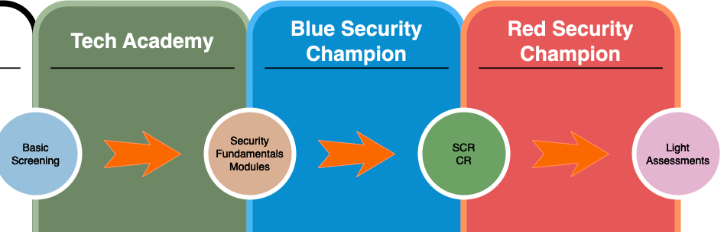
Learning path

Slide 6
Security Champions Training: Blue and Red
Registration: Security Champions enroll through an approved training platform.
Blue Training: Advanced Secure Development for Security Champions focuses on common web application vulnerabilities, detection, and mitigation techniques.
Red Training: Advanced Web Hacking for DevOps provides hands-on exposure to penetration testing and security best practices.
Current Training Approach: The Blue course is a self-study program supported by interactive learning platforms and real-world application exercises.
Bootcamp Structure: A two-week, hands-on learning experience for engineers interested in strengthening application security. The last day includes an exam, and successful participants are certified as “Blue” Security Champions.
Post-Training Capabilities: Certified Champions can determine when security tests are needed, provide security support, approve security change reviews, and act as the primary security contact for their teams.

Slide 7
Benefits
Incentives:
Help your team grow in their Security Maturity and include Security in every stage of the SDLC.
Create safer applications together and shorten time to market.
Gain more Security awareness in the team.
Take control of security testing during SDLC.
Master advanced security skills.

Slide 8





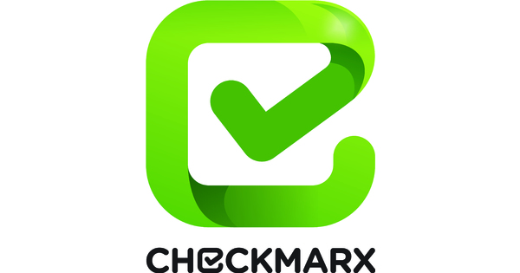
Maturity levels and benefits
Levels
Trainings
Benefits
Advanced Security Champions
OWASP SKF implemented
Step 1,2,3 and 4 of the Change Review
Unlimited Change Reviews
Trust them!
Blue Security champions
Threat Modeling
Step 1,2 and 3 of the Change Review
Unlimited Change Reviews
Limited trust and freedom
Basic Security Champion training
Step 1 of the Change Review
Ad-Hoc
It works!

Slide 9





Security in OnePipeline
Threat modelling
Blue Champion
Threat Modelling
Security Team
Design Review
Red Champion
Design
Build
Deploy
Test
Release
Blue Champion
Secure Code Training
Red Champion
Secure Training
Risk Journey

Slide 10


Security in OnePipeline
BDD Security Tests
DevOps Team
Build
Design
Deploy
Test
Release
4-Eyes Principle
Peer Reviews
DevOps Team
Risk Journey

Slide 11

Security in OnePipeline
SAST/SCA Tool
Deploy
Design
Build
Test
Release
SAST/SCA Tool
SAST/SCA Tooling
Risk Journey

Slide 12

Security in OnePipeline… New WoW
SCR
Blue Champion
Maturity level =>3
Security Champions
Light PT
Change Review
Red Champion
Maturity level < 3
Security Team
Test
Design
Build
Deploy
Release
PT
Initial Release
Security Team
SCR
Risk Journey

Slide 13
Summary on key changes
DevOps teams integrate security effectively across all stages of the development lifecycle using modern CI/CD solutions to achieve secure-by-design practices.
Security testing efforts are tailored to the nature of IT changes, balancing resources and quality of security testing—there is no one-size-fits-all approach.
Security Champions possess both development knowledge and a deep understanding of security requirements essential to their applications.
Over time, DevOps teams will rely less on centralized security teams, reducing time-to-market while maintaining high-security quality.

Slide 14
Only together we can make this work
Some key elements to think about:
Security Champions performing change reviews need sufficient time to ensure thorough evaluations. Rushing them can compromise security.
Management can support the program by allocating dedicated time per sprint for Security Champions.
Integrating security into every sprint fosters a security-aware mindset across the team.
Ask yourself: Will my next action improve application security, or should we take additional steps to enhance protection?

